Slide 1
Layouts in JAVA

Slide 2
Layout
Layout means the arrangement of components within the container. In other way we can say that placing the components at a particular position within the container. The task of laying out the controls is done automatically by the Layout Manager.

Slide 3
Layout Managers
A Layout Manager directs the placement of Components within a Container.
Each container has a layout manager, which is responsible for arranging the components in a container.
The container's setLayout method can be used to set a layout manager.
The layout manager places the components according to the layout manager's rules, property settings and the constraints associated with each component.
Each layout manager has a particular set of rules specific to that layout manager.

Slide 4
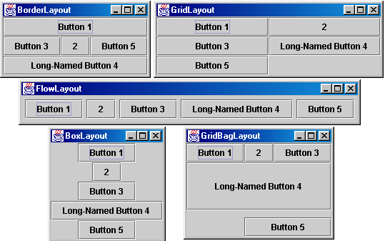
Layout Managers

Slide 5
FlowLayout
FlowLayout
Simplest layout manager
Components are placed left to right in the order they are added
If there is not enough space for all the components to fit, they'll be moved to the next line.
Components can be left aligned, centered or right aligned
Constructors
FlowLayout()
This creates the default layout, which centers components and leaves five pixels of space
between each component
- FlowLayout(int how)
This form lets you specify how each line is aligned. Valid values for how are as follows: FlowLayout.LEFT, FlowLayout.RIGHT, FlowLayout.CENTER
FlowLayout(int how, int hGap, int vGap)
Specify the alignment as well as the horizontal and vertical spacing between components

Slide 6
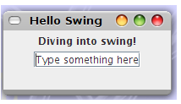
import javax.swing.JFrame;
import javax.swing.JLabel;
import javax.swing.JTextField;
public class LabelnText
{
public static void main(String[] args)
{
JFrame frame = new JFrame("Hello Swing");
frame.setSize(200, 100); frame.setDefaultCloseOperation(JFrame.EXIT_ON_CLOSE);
frame.setLayout(new FlowLayout());
frame.add(new JLabel("Diving into swing!"));
frame.add(new JTextField("Type something here")); frame.setVisible(true);
}
}

Slide 7
BorderLayout
The BorderLayout class implements a common layout style for top-level windows.
It has four narrow, fixed-width components at the edges and one large area in the center.
The four sides are referred to as north, south, east, and west. The middle area is called the center.
The constructors defined by BorderLayout:
BorderLayout( )
BorderLayout(int horz, int vert)

Slide 8
BorderLayout defines the following constants that specify the regions:
BorderLayout.CENTER
BorderLayout.SOUTH
BorderLayout.EAST
BorderLayout.WEST
BorderLayout.NORTH
When adding components, you will use these constants with the following form of
add( ), which is defined by Container:
void add(Component compObj, Object region);
Here, compObj is the component to be added, and region specifies where the component will be added.

Slide 9
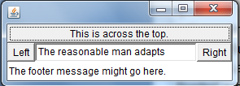
public class BorderLayoutDemo extends JFrame
{
public BorderLayoutDemo()
{
setLayout(new BorderLayout());
add(new Button("This is across the top."),BorderLayout.NORTH);
add(new Label("The footer message might go here."),
BorderLayout.SOUTH);
add(new Button("Right"), BorderLayout.EAST);
add(new Button("Left"), BorderLayout.WEST);
String msg = "The reasonable man adapts “
add(new TextArea(msg), BorderLayout.CENTER);
}
public static void main(String[] a)
{
abc obj=new abc();
obj.setVisible(true);
obj.pack();
}
}

Slide 10
GridLayout
GridLayout
Divides window into equal-sized rectangles based upon the number of rows and columns specified
Items placed into cells left-to-right, top-to-bottom, based on the order added to the container
Ignores the preferred size of the component; each component is resized to fit into its grid cell. So, Every component has the same width and height
Too few components results in blank cells
Too many components results in extra columns

Slide 11
GridLayout (Continued)
Constructors
GridLayout()
Creates a single row with one column allocated per component
GridLayout(int rows, int cols)
Divides the window into the specified number of rows and columns
Either rows or cols (but not both) can be zero
GridLayout(int rows, int cols, int hGap, int vGap)
Uses the specified gaps between cells

Slide 12
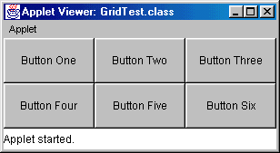
GridLayout, Example
public class GridTest extends Applet
{
public void init()
{
setLayout(new GridLayout(2,3)); // 2 rows, 3 cols
add(new Button("Button One"));
add(new Button("Button Two"));
add(new Button("Button Three"));
add(new Button("Button Four"));
add(new Button("Button Five"));
add(new Button("Button Six"));
}
}

Slide 13
GridBagLayout
Behavior
Divides the window into grids, without requiring the components to be the same size
Each component managed by a grid bag layout is associated with an instance of GridBagConstraints
The GridBagConstraints specifies:
How the component is laid out in the display area
In which cell the component starts and ends
How the component stretches when extra room is available
Alignment in cells

Slide 14
GridBagLayout: Basic Steps
Set the layout, saving a reference to it
GridBagLayout layout = new GridBagLayout();
setLayout(layout);
Allocate a GridBagConstraints object
GridBagConstraints constraints =
new GridBagConstraints();
Set up the GridBagConstraints for component 1
constraints.gridx = x1;
constraints.gridy = y1;
constraints.gridwidth = width1;
constraints.gridheight = height1;
Add component 1 to the window, including constraints
add(component1, constraints);
Repeat the last two steps for each remaining component

Slide 15
GridBagConstraints
Copied when component added to window
Thus, can reuse the GridBagConstraints
GridBagConstraints constraints = new GridBagConstraints();
constraints.gridx = x1;
constraints.gridy = y1;
constraints.gridwidth = width1;
constraints.gridheight = height1;
add(component1, constraints);
constraints.gridx = x1;
constraints.gridy = y1;
add(component2, constraints);

Slide 16
GridBagConstraints Fields
gridx, gridy
Specifies the top-left corner of the component
Upper left of grid is located at (gridx, gridy)=(0,0)
Set to GridBagConstraints.RELATIVE to auto-increment row/column
GridBagConstraints constraints = new GridBagConstraints();
constraints.gridx = GridBagConstraints.RELATIVE;
container.add(new Button("one"), constraints);
container.add(new Button("two"), constraints);

Slide 17
GridBagConstraints Fields (Continued)
gridwidth, gridheight
Specifies the number of columns and rows the Component occupies
constraints.gridwidth = 3;
GridBagConstraints.REMAINDER lets the component take up the remainder of the row/column
weightx, weighty
Specifies how much the cell will stretch in the x or y direction if space is left over
constraints.weightx = 3.0;
Constraint affects the cell, not the component (use fill)
Use a value of 0.0 for no expansion in a direction
Values are relative, not absolute

Slide 18
GridBagConstraints Fields (Continued)
fill
Specifies what to do to an element that is smaller than the cell size constraints.fill = GridBagConstraints.VERTICAL;
The size of row/column is determined by the widest/tallest element in it
Can be NONE, HORIZONTAL, VERTICAL, or BOTH
anchor
If the fill is set to GridBagConstraints.NONE, then the anchor field determines where the component is placed
constraints.anchor = GridBagConstraints.NORTHEAST;
Can be NORTH, EAST, SOUTH, WEST, NORTHEAST, NORTHWEST, SOUTHEAST, or SOUTHWEST

